Slide 1
Life Cycles
Paul-David Jarvis

Slide 2
Task 1

Slide 3
Product Life Cycle
The product life has 6 stages to developing a product: Requirement Analysis, Design, Testing, Implementation, Deployment and Maintenance.
Notes:
Introduce the product life cycle and state the 6 stages of the life cycle.

Slide 4
Requirement Analysis
This part of the life cycle is where we determine the needs and conditions for our project. It’s critical to the success and failure of our project and these requirements should be documented, measurable and testable etc. The advantages of the requirement analysis phase is that it can provide a checklist for the project and weaknesses is that such checklists can run up hundreds of pages. Non-functional and functional requirements are only some of the requirements needed for this phase. Functional requirements explain and identify the necessary task, action or activity that needs to be complete. Non-functional requirements specify criteria that is used to judge the operating system rather specific behavior.
Notes:
Requirement Analysis is when we find out what we actually need to do for the client. Emphasise the importance of this stage to the overall product. Describe what is functional (WHAT IT DOES) and nonfunctional (HOW IT DOES IT) requirements.

Slide 5
Design
This stage is to work out the details of the program. This includes designing the visual appearance, the software programming and can be done by designing a variety of diagrams such as pseudo code, Data-flow and flowcharts. This is the stage where you develop and document a bunch of models for the business system such as using unified modelling language for case diagrams, activity diagrams etc.
Notes:
Emphasise the importance of having extremely detailed diagrams which will help develop the product or system. List several diagrams that can be used to show the design: DFD, UML. FLOWCHARTS.

Slide 6
Testing
This stage involves testing the program under the conditions given by your client. You need to identify any bugs or glitches in this stage. The testing stage is important to making sure that your product actually works. During the testing stage, the developers would typically try to discover bugs or errors that have to be fixed before the product is deployed for beta testers.
This could be shown by a testing table where you list several tests that could be done and your expectation of the result and the actual result.
Notes:
Emphasise the importance of debugging, fixing errors within your program. Describe a test table, saying that you can perform a variety of tests with the conditions that the client want.

Slide 7
Implementation
The implementation stage is where your product is written using a variety of coding languages such as visual basic, C, javascript and python etc. This stage relies on the amount of details of all your diagrams you would’ve designed during the design stage. If all your diagrams are well done then the implementation stage should be relatively easy as all your variables and datatypes are written down, the processes and data stores are in your diagrams etc.
Notes:
Talk about how your program will be produced such as using VBE and databases.

Slide 8
Deployment
The deployment stage is when the product is released to the public and they’re to use the product and provide feedback. This stage is efficient for routing out errors as the chances of finding serious problems within your product increase with everyone who uses it.
Notes:
Talk about how the product will be deployed and emphasise the importance of feedback as it is used to fix problems.

Slide 9
Maintenance
The Maintenance stage is when the product is maintain to fix any new bugs or glitches. This stage relies heavily on the deployment stage as the errors and bugs found within the product are given back in feedback and then the maintenance stage can start when you identify the problems that need to be fixed.
Notes:
Maintenance stage is vital. Emphasise the importance of maintaining a product or system to fix any new errors or bugs that could be used to manipulate the product.

Slide 10
System Life Cycle
The system life cycle is used in software engineering to develop a ICT system. There are several phases of the system life cycle: Feasibility Study, Analysis, System Design, Development, Testing, Deployment, Maintenance and Review.

Slide 11
Feasibility Study
The feasibility study is an investigation to find out the main problems in their system and whether a new is cost-effective.
It will contain descriptions of the existing systems with their functional and non-functional features, a statement which describes the original problems, the functional and nonfunctional requirements of the new product or system, some alternative solutions, several factors that will have to be considered such as technical, economic, legal and social and finally a recommendation on how to proceed.
Notes:
Talk about how the feasibility study is used to gather all the information needed to develop a system for the client.

Slide 12
Analysis
This stage is where you analyse the requirements given by the client and what the product will achieve. Using a variety of techniques like questionnaires and interviews.
Requirement analysis is where you discuss with the client to identify their requirements such as functional and non-functional requirements, a certain time period and a certain budget.
System analysis is where we look at what the system will do and what functional and non-functional requirements it will provide. This will help to achieve the goals that the client wants.
Notes:
Talk about analysing the product and the system that the client want. Talk about the potential constraints such as budget, information or a time period.

Slide 13
System Design
The system design stage is where planning for all the details for the ICT system takes place. This will include a bunch of visual diagrams such as data-flow diagram, flow charts, entity relationships diagram, hierarchy tree diagram, entity life history, case diagram, activity diagrams.
Notes:
Talk about the diagrams that could be used to help design the system such as DFDS, FLOWCHARTS, ERDS.

Slide 14
Development
The development stage is done only when you and the client have agreed on an ideal ICT system. This stage will be made relatively easier if your diagrams in the system design stage are extremely detailed. During this stage the programming and actual development of the ICT system.
Notes:
Talk about how you will develop the system and what makes it the right thing that the clients are looking for.

Slide 15
Testing
During the testing stage, the ICT system will be monitored to identify any bugs, errors or functional requirements that aren’t working as they were originally designed for.
Notes:
Emphasise the importance of the testing stage as this will root out any issues or problems before we release it to the client.

Slide 16
Deployment
Deployment is the stage when we will roll out the system that we’ve been developing to the client.
Notes:
Talk about deploying the system to the client.

Slide 17
Maintenance
This stage is after the ICT system is with the client. The system will still have maintenance done on it incase the clients discover any new bugs or errors.
Notes:
Emphasise the importance of maintaining a product or system after we’ve finished, this is to fix and problems that may occur when in the client’s hands.

Slide 18
Review
The final stage of the system development life cycle is the review stage. During this stage the overall project and build of the ICT system will be reviewed as well as all the client’s feedback about his new system.
Notes:
Talk about reviewing the product or system at the end, the goods, the bads. Evaluate the entire project.

Slide 19
Bibliology
Product Life Cycle
System Life Cycle
http://productlifecyclestages.com/new-product-development-stages/
https://blog.udemy.com/product-development-life-cycle/
https://revisionworld.com/gcse-revision/ict/system-life-cycle
https://www.bbc.co.uk/education/guides/z8n3d2p/revision
https://en.wikipedia.org/wiki/Systems_development_life_cycle
https://shaparo-mis.wikispaces.com/System+Development+Life+Cycle

Slide 20
Task 2

Slide 21
Pitch
By Paul-David Jarvis

Slide 22
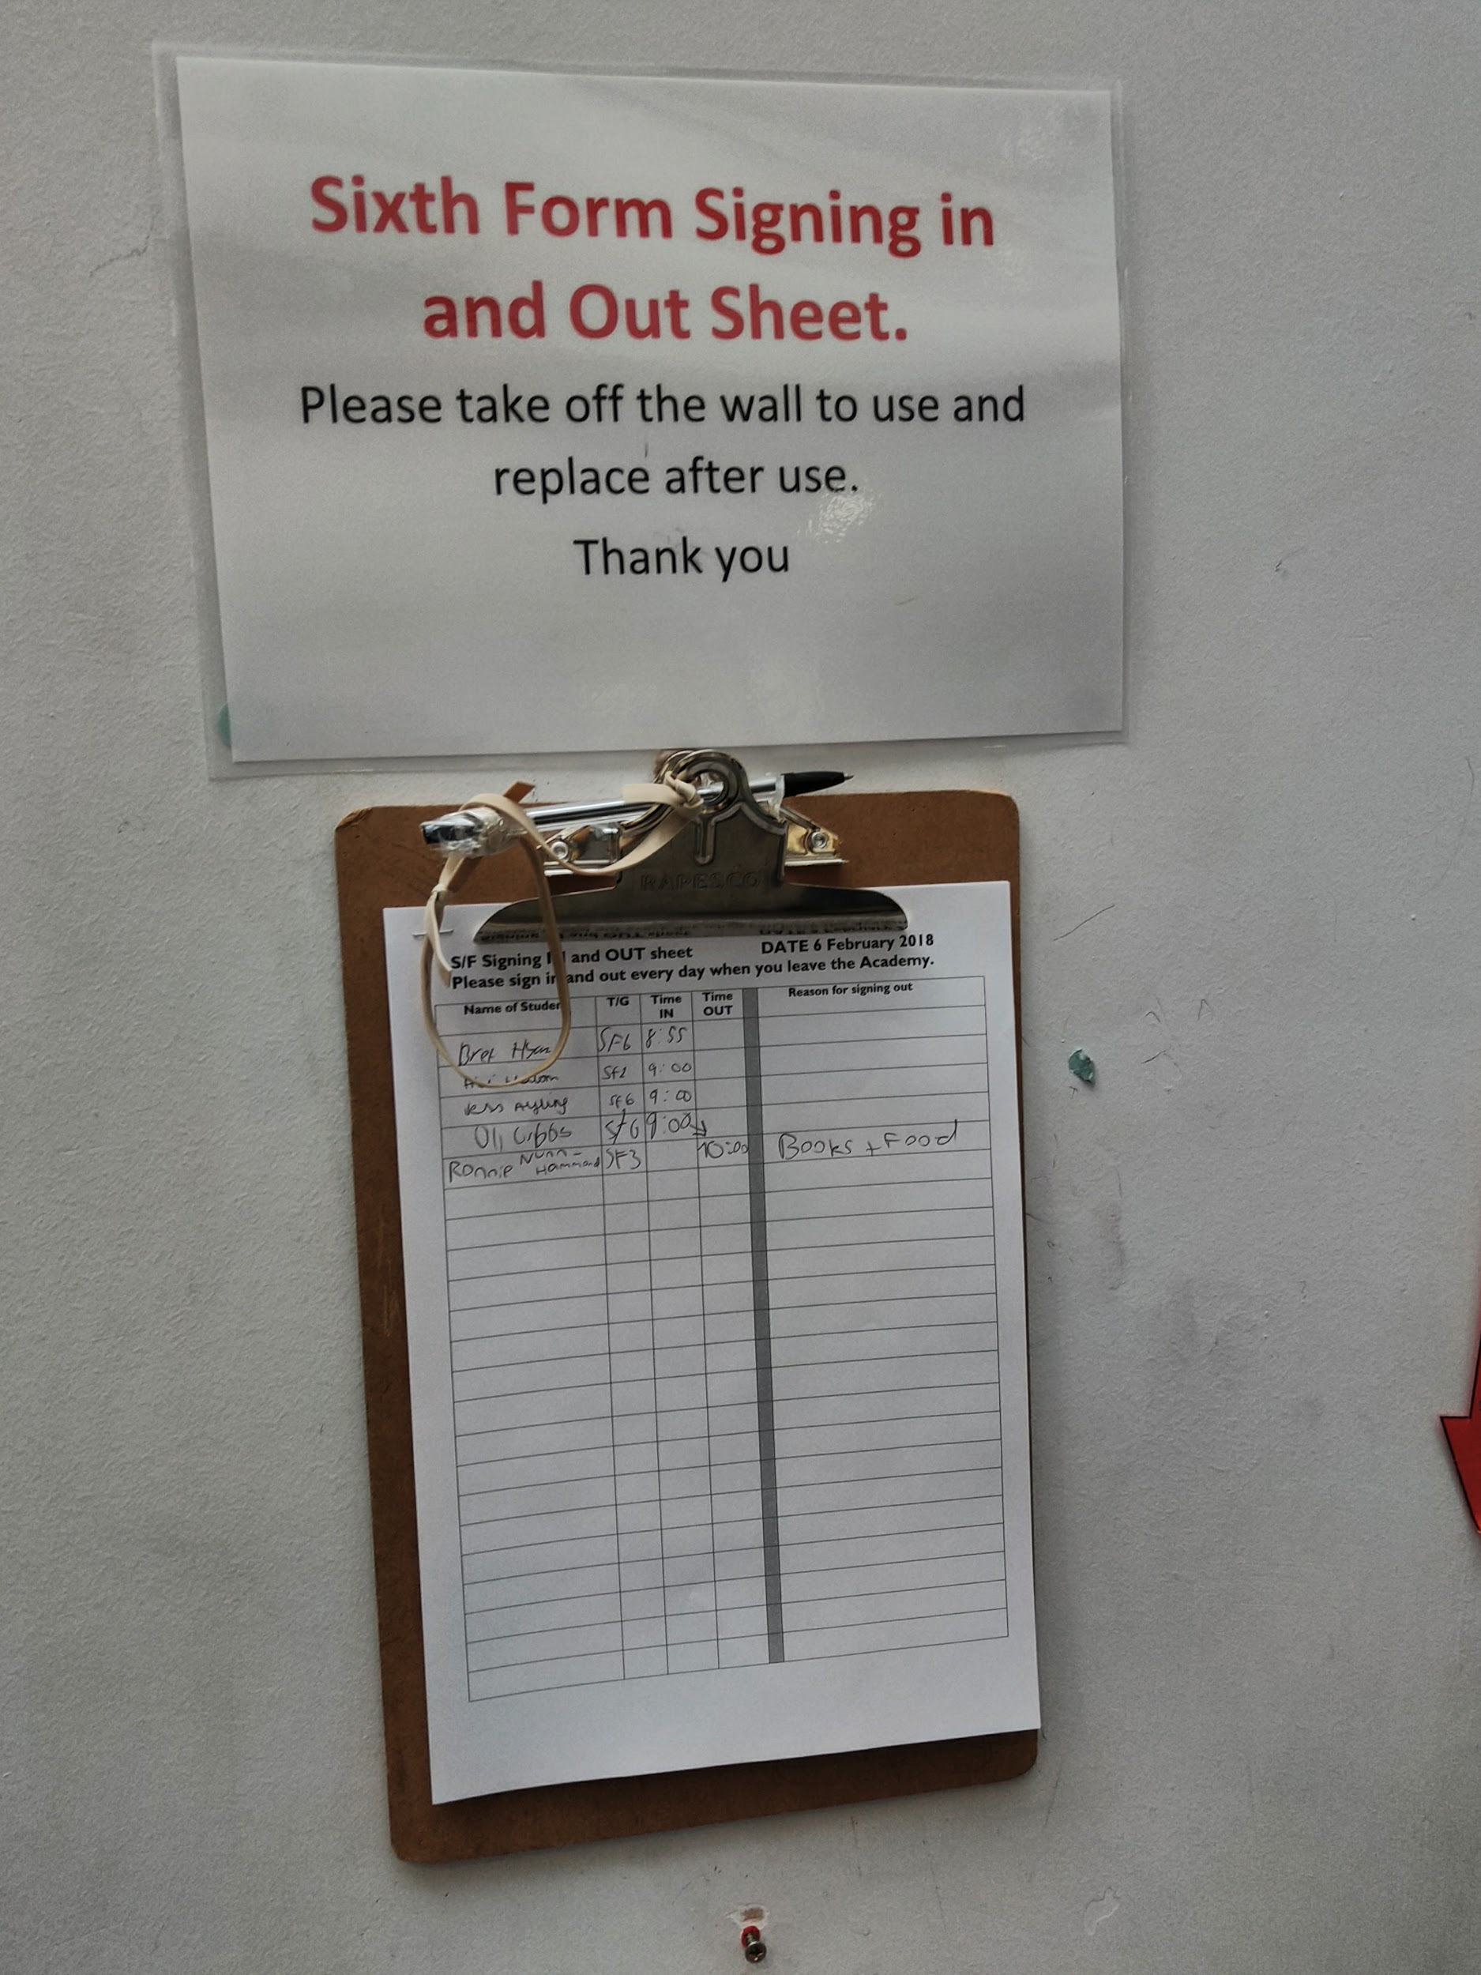
Introduction to the client
This new student management system will allow the students to simply register either in or out. It is a automated version of the paper based system that The Littlehampton Academy are currently using. This new system will allow students to retrieve their timetables and be able to register in or out. Staff will be able to retrieve student’s timetable and are able to access the emergency menu to check whether students have arrived at the emergency point.

Slide 23
System Requirement Analysis
Problem with the original system:
Your current system is a paper based system which every class has. Paper can be lost or ruined which could cause major issues in an emergency situation where you need to know who is at the designated emergency point and who is not in school or is not at that point. We will be unable to say for certain which students could be in a life threatening situation.
Existing Systems:
Student details are being maintained on a few applications. So searching for the students details on both SIMS and GO4SCHOOLS is tedious and not efficient.
Proposed System:
This new system will allow students to use the school computers or Citrix to log in and out of school. The data is saved to a flat file and incase of an emergency like a fire drill, the data can be read with a push of a button and inserting the class number. This system could have new functionality added to it which allows the data from both SIMS and GO4SCHOOLS to be stored with the data from the new system.

Slide 24
Functional and non-functional requirements
Functional Requirements
Non-Functional Requirements
Inputs the student’s name, class and reason for signing in or out.
Save student’s data.
Display specific data.
Outputs a message that confirms registration
Has a simple front end for students with less experience.
Constantly connected to the backend whether Microsoft Access, SIMS, GO4SCHOOLS or RealSmart
Store new data into a Microsoft Access database using data adapters.
Display data by reading the database using a filter to filter the class input on the emergency menu.
Outputs a message box to the user saying that he signed out and save the results to a database.
Password protected for security
Easy to learn for all students with different knowledge
Security: On a secured network protected by a password with an addition password for students.

Slide 25
Outline Solutions
The school wants to be able to access a snapshot of the students who are still on the ground. The functional requirement is that they will be able to access the database from the teacher’s menu. The non-functional requirement is that it should always be available to retrieve and should have great performance such as a excellent response time.
The school wants to keep the class data separately. This is done by using the sign in and out forms and allowing the user to input their class. The data is stored by using datatables and SQL statements to determine what class they entered. It is quick and efficient and allows the system to filter the data using class criteria.

Slide 26
Google Sheet Solution
There is another solution that we could do instead of using Visual Basic and Microsoft Access as a backend. We can use Google Sheets which is the free online version of Microsoft Excel.
The school already uses Google Drive which allows students to upload the work to the cloud and eliminates the possibility of lost work. The school uses realsmart which is a online intranet service that makes the students life easier as it can link all their subjects and allow teachers to share documents with the use of Google Drive.
With all the pros of Google Drive, there are cons and that would be accessing Google Drive. As it’s a online service using the cloud it requires a constant internet connection. It also requires a device that can access the web such as a smart phone or computer, which the school has all the requirements.
This system will have the same functional and nonfunctional requirements overall. The ability for students to sign in and out, view their timetable and teachers are able to access a emergency snapshot to check whether students are in or out incase in a emergency.
The non functional requirements are that the system needs a constant connection to internet, a simple user interface and security features such as password protected network and spreadsheet.

Slide 27
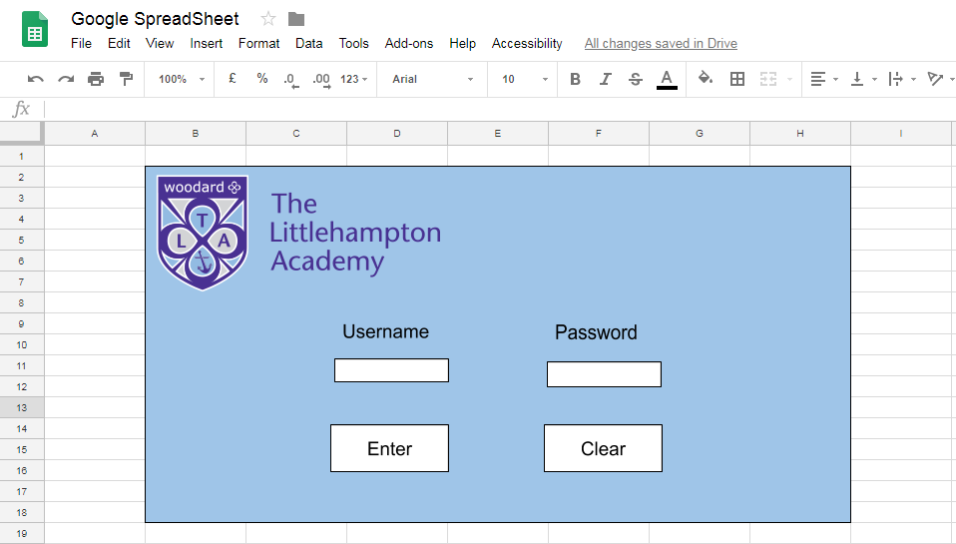

Slide 28
The Purpose
The system should ask for a variety of inputs such as the student’s name, their class and the reason why they’re signing in and out of the Sixth Form.
The data of the student’s will be stored separately depending on whatever class the student is in, the data will be stored in a database and the time of signing in or out will be automatically stored to increase the accuracy.
Incase of an emergency at The Littlehampton Academy, tutors or admin staff will be able to access the database in order to display the student’s data so they can determine who’s safe and who still might be in the school.

Slide 29
Context
The Littlehampton Academy already have several systems in place such as SIMS or GO4SCHOOLS. The product that IT Guru ™ are developing could work together with their other system or could replace them.
The systems that The Littlehampton Academy already work and the main problem is that the current paper based system is rarely used due to the location.

Slide 30
Assumptions
The Littlehampton Academy have computers which are running Windows 7 operating system. They also run a thin client Citrix system and in addition to this they have laptops and tablets which are used by the students.
The clients have a lack of knowledge, however they do have a Network Services team of four who ensure that the school network antivirus software is up to date and make sure that their network security policies are in place.

Slide 31
Potential Constraints
Interoperability with systems that The Littlehampton Academy are already using such as SIMS or GO4SCHOOLS. However The Littlehampton Academy has asked that this product is allowed to be analysed by other programs like GO4SCHOOLS or SIMS.
There are several different possible programs that you can design this product in. Visual Basic Express allows you to develop windows applications based on .NET Framework. In addition, it includes a very nice and clean interface. This will be beneficial as VBE interface is very easy to navigate and learn which means that their lack of knowledge will not be a issue.
Financial is also another potential constraint. The Littlehampton Academy is a public school which could suggest that they have budget constraints. Money is a very important factor when developing a product; it requires highly skilled developers which will cost money, without that money, skilled developers will not be paid and your product will not be developed.

Slide 32
Implementation Plan
Test the program to workout any issues that could affect the program running efficiently.
Remove current based paper system as this system will be used instead of the Sixth Form signin and signout paper based and the emergency paper based checklist.
The next part of the plan is rolling out the systems on the network so every student can access the program.
Connect the database to the program which holds all the tables. These tables hold all the student and teacher login details as well as where the signin and signout information will be stored.
Maintain the system incase any bugs or issues are discovered.

Slide 33
Important Dates
The system will be rolled out on the 20th of August 2018.
Testing will begin soon after the system is implemented and will allow students to report and give feedback on things that can be improved.
Maintenance has been scheduled for the 5th of October 2018, we will begin to fix any bugs that were reported during the testing stage.
Mr. Voice has the right to cancel the project if he feels that this system no longer fits his needs or the colleges.

Slide 34
Task 3

Slide 35
Student Registration System PowerPoint
By Paul-David Jarvis

Slide 36
The Idea
The overall goal of this program is to make life easier for you. Our idea is to have a registration system on the computers or even on your phone. Instead of having to attend registration, you’re able to use your phone to register yourself in or out.
Missed registration? Instead of having to walk all the way to the main building where your current paper based system is, you’re able to do it from your classroom or from the comfort of the sofas in the group study room.

Slide 37
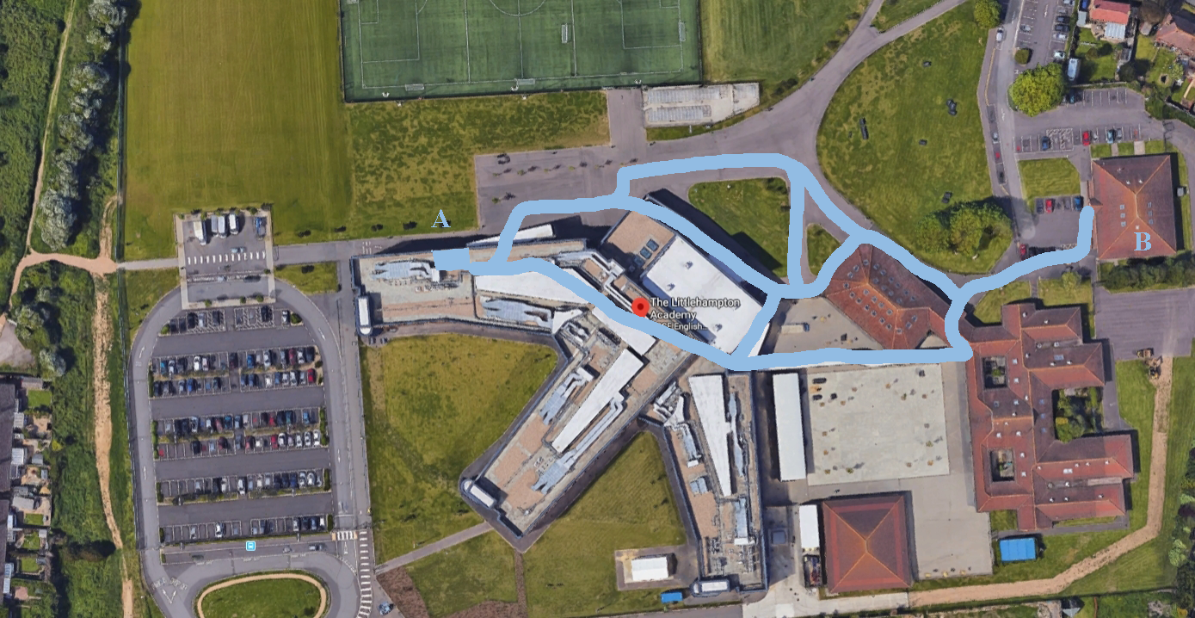
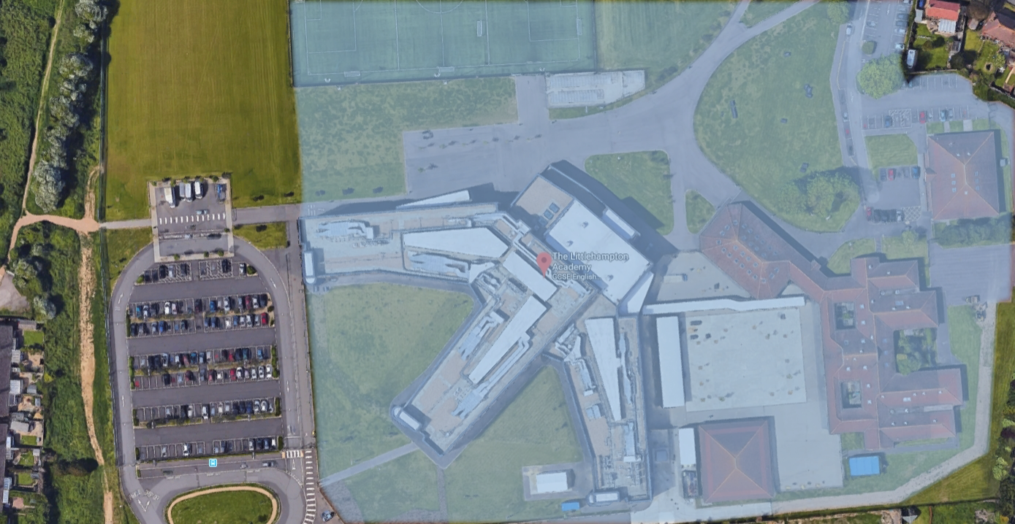
Accessibility
These two pictures are of the school grounds. The first one is with the current based paper system in which you have to walk from point B to A using the highlighted paths to register. The second picture is the range you will have when our new system is implemented.

Slide 38
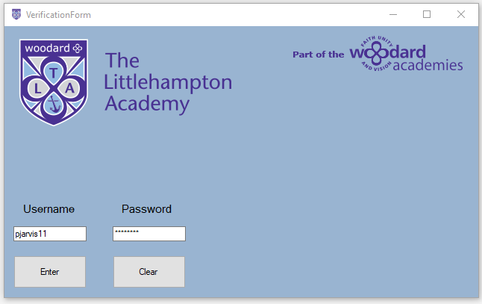
Security
This application will require your username and password which you use everyday for the computers, printers etc. If you need a new password or forgot it then you can just ask the IT technicians.

Slide 39
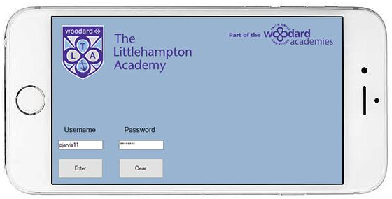
Information Age
The 21st century is also the information age which is also known as the computer age, digital age or new media age. This didn’t escape us when developing this program so that is why it’s available on IOS, Windows, Android OS for your smartphones.

Slide 40
FAQ
Q: Why can’t I just stay home and register in?
A: This system will only work when connected to the schools or college WiFi.
Q: Why do we need this new system for?
A: So many students don’t sign out because they don’t want to walk over to the main building. This system will eliminate that and make it overall easier.
Q: Will I be able to view my timetable from this application?
A: Yes! This application doesn’t only make it easier to sign in and out but when you’re signing in you will be able to see your timetable just before.

Slide 41
Review Presentation
By Paul-David Jarvis

Slide 42
Functional and non-functional requirements
Functional Requirements
Non-Functional Requirements
Login and Logout.
Register In and Out.
Display Students Timetables.
Display a list of Students who’ve signed in but not out.
Filter emergency data by class, first name and last name.
Print out emergency data.
Stores registration data in a table using data adapters.
Reads students registration data and displays it on the emergency menu.
Reads and sorts emergency data by their class, firstname and lastname.
Outputs a message box to the user saying that he signed out and save the results to a database.

Slide 43
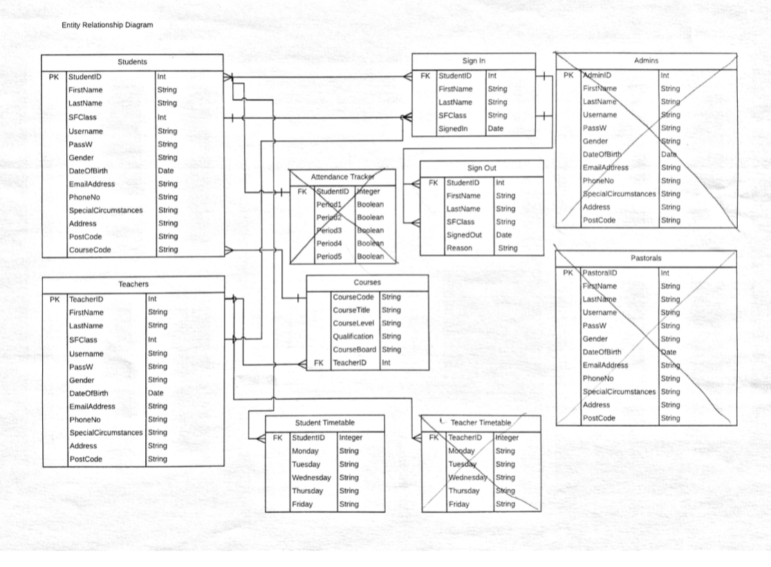
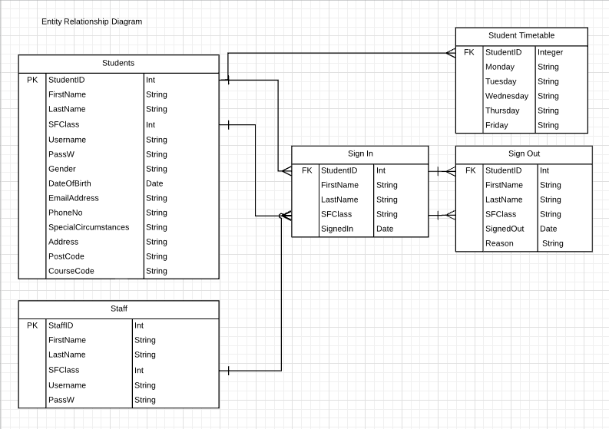
Entity Relationship Diagram
Below are two entity relationship diagrams that I’ve designed for my system. The first diagram was one that me and our stakeholders went over and made improvements. We decided to remove several entities such as the admins, pastorals, attendance tracker and teacher timetables. We decided that we did this wasn’t necessary for what the stakeholder wanted so instead we combined all the staff into a single entity (“Staff”).

Slide 44
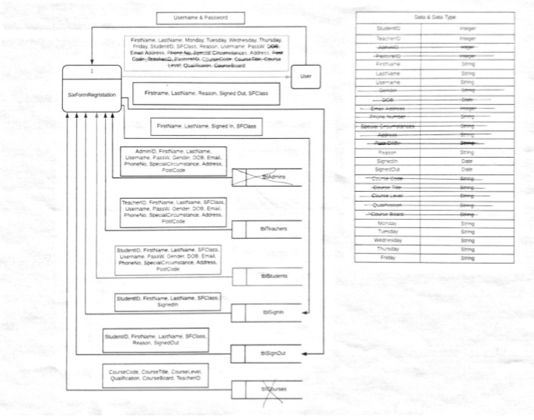
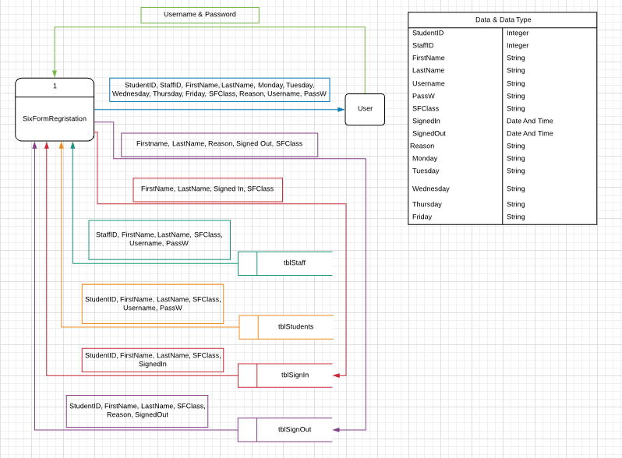
Data Flow Diagram Level 0
We also designed some data flow diagrams which we have shown to our stakeholders and have edited it. The stakeholder decided to remove several entities such as admins and pastorals as well as some others. The first diagram shows that some of the data variables in the data table have been crossed out as we no longer need them as well as some of the data storages.

Slide 45
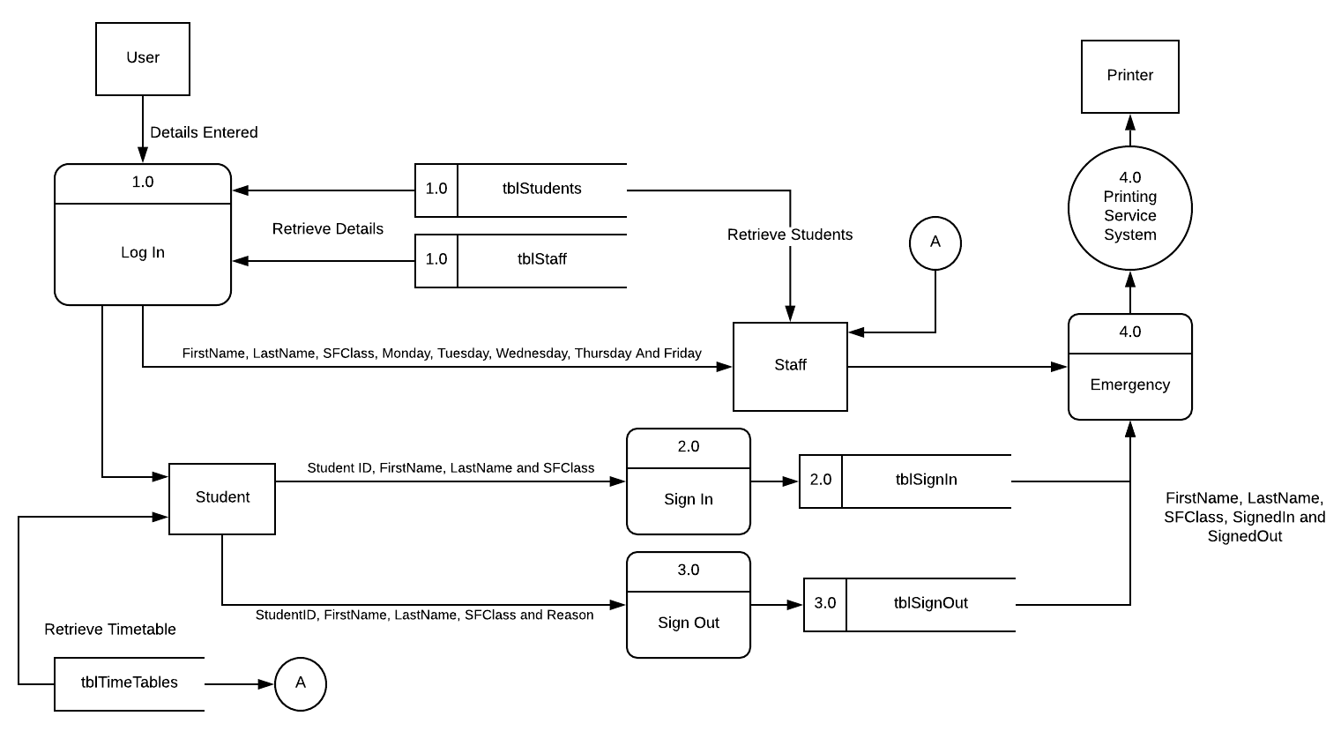
Data Flow Diagram Level 1
A level 1 Data Flow Diagram is a more broken down diagram that shows all the processes inside the system rather then just the system which is show in a level 0 diagram. A level 1 diagram will show how the processes works with entities and where the data is going to and from. As you can see from the diagram below, we have a more complex look inside the system.

Slide 46
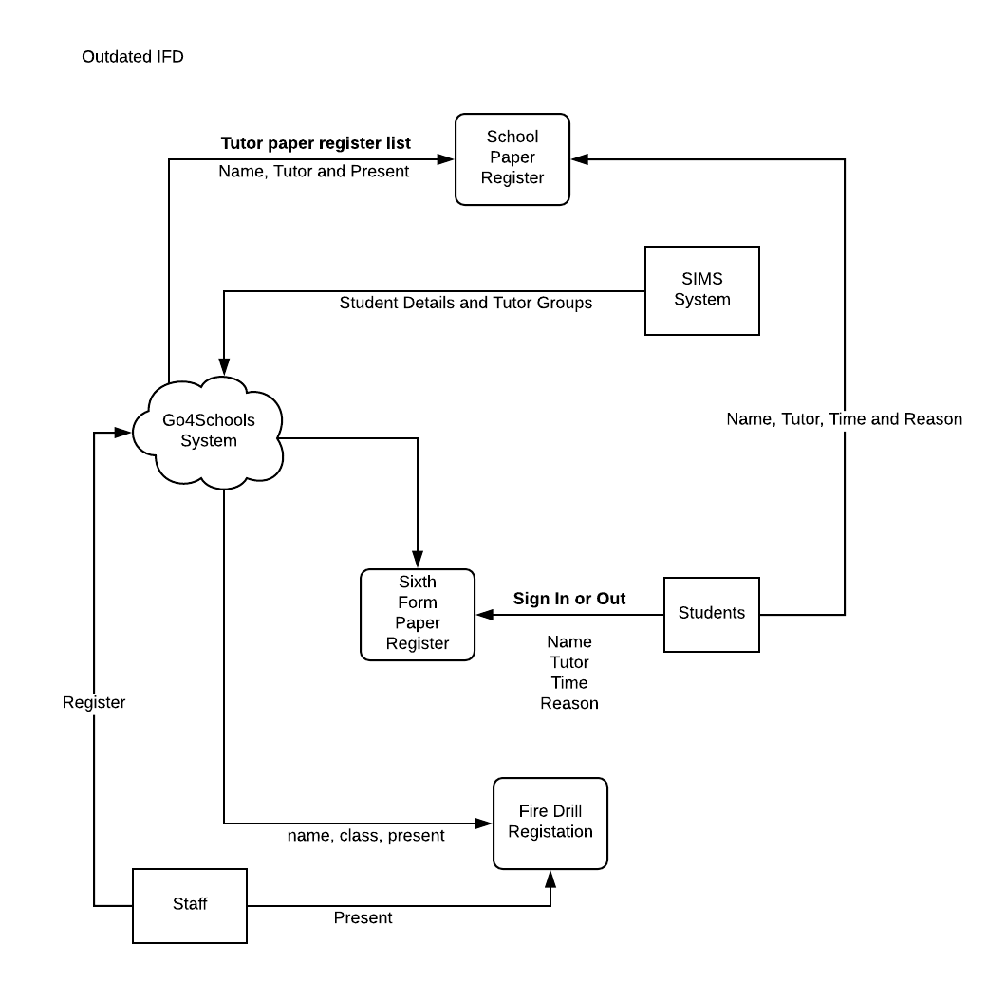
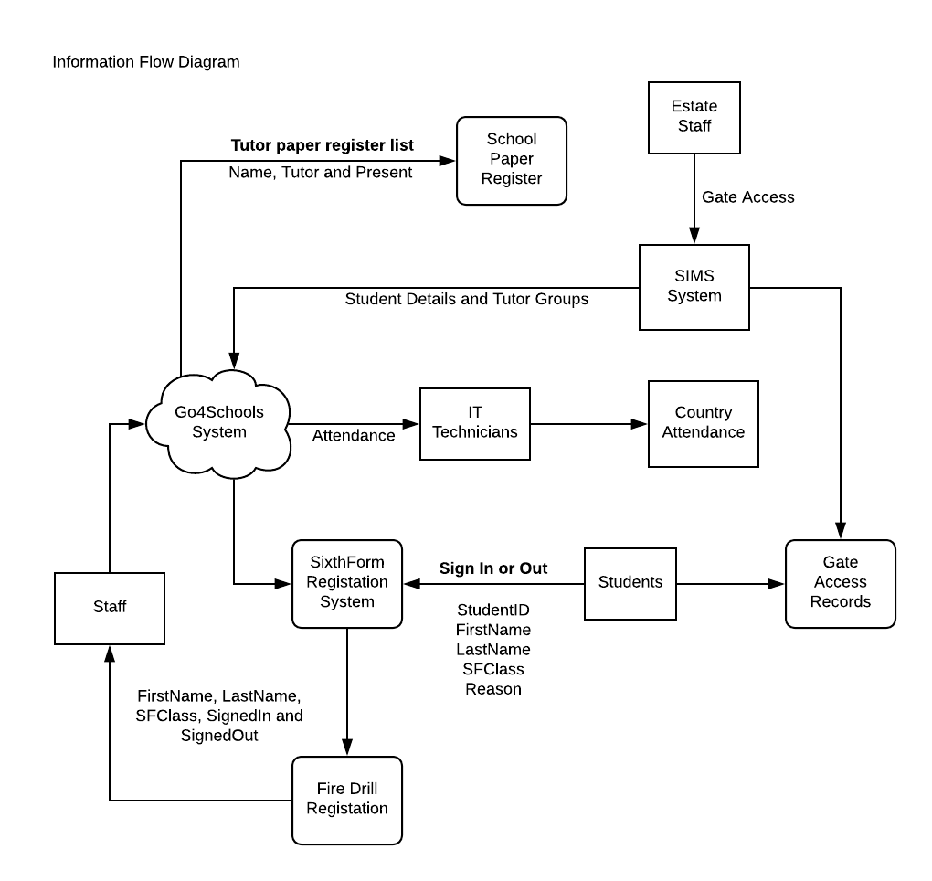
Information Flow Diagram
This diagram shows how our system will interact with the other systems inside The Littlehampton Academy. The first diagram is the current systems and how they interact with the entities and other processes. The second diagram is what we are proposing, as you can tell we have proposed several differences that we feel will satisfy the stakeholders. We suggest the ability for students to be marked in if they swipe their card and the fire drill registration will be automatically done without the need for staff members to mark students present or not.

Slide 47
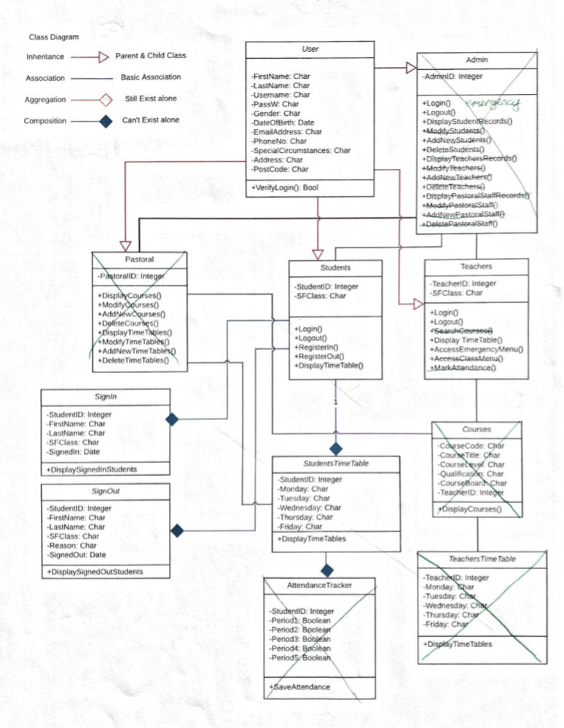
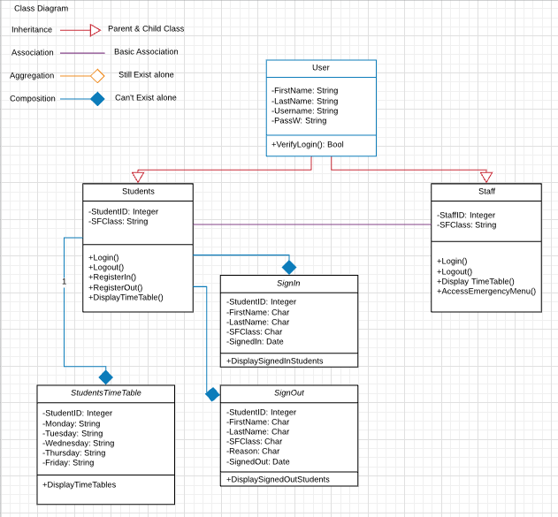
Class Diagram
As Well as designing data flow and entity relationship diagrams we also designed a class diagram. The first picture is the first diagram that me and our stakeholders went over and edited. You can see that some classes have been crossed out as we no longer need them. The pastoral, admin, courses, attendance tracker and teacher time table classes have been crossed out.

Slide 48
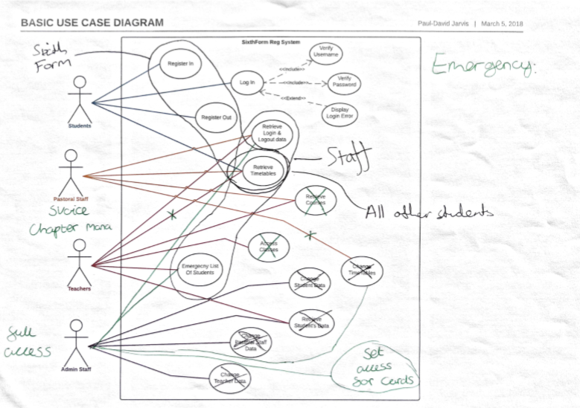
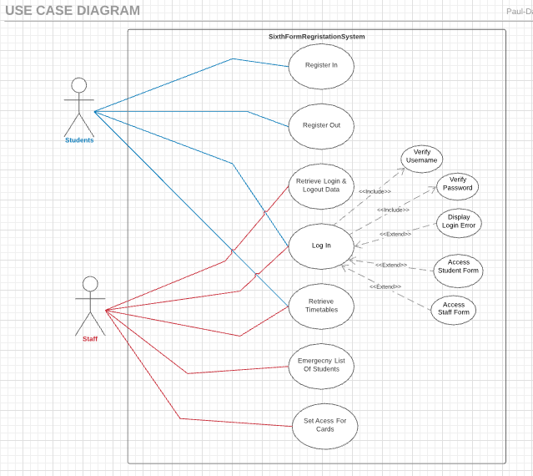
Basic Use Case Diagram
During the design phase of this project we also designed a basic use case diagram that me and stakeholder went over and edited. The first diagram is the first diagram that have been edited which we can see that we removed the teachers and pastoral staff users as well as removing some of the use cases. We have also added one or two other use cases as well as limiting some use cases to certain users.

Slide 49
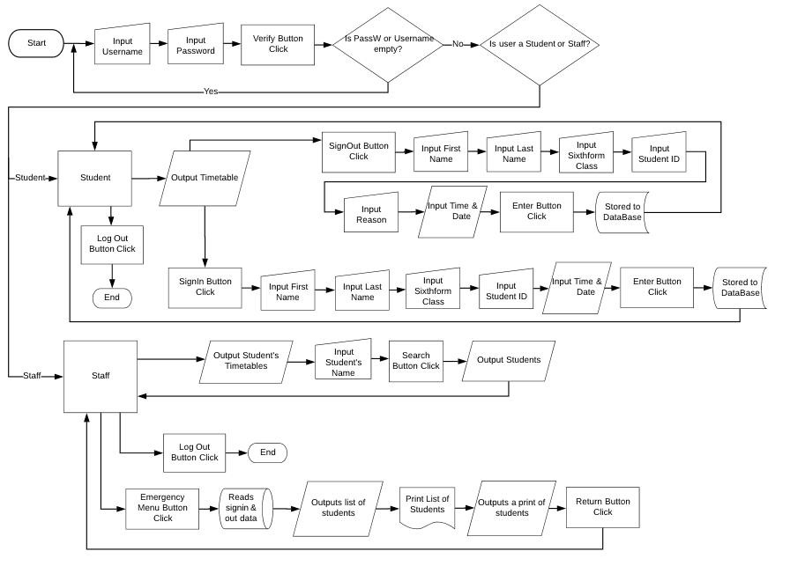
Flowchart Diagram
We also designed a flowchart during the design phase of our project. This diagram shows our stakeholder the algorithm or process that our project will do and take, as well as the options on either the student or staff side. The flowchart shows the steps that our project takes in several different boxes. This includes the start and end, manuel inputs, decisions made and where data is saved to the database.

Slide 50
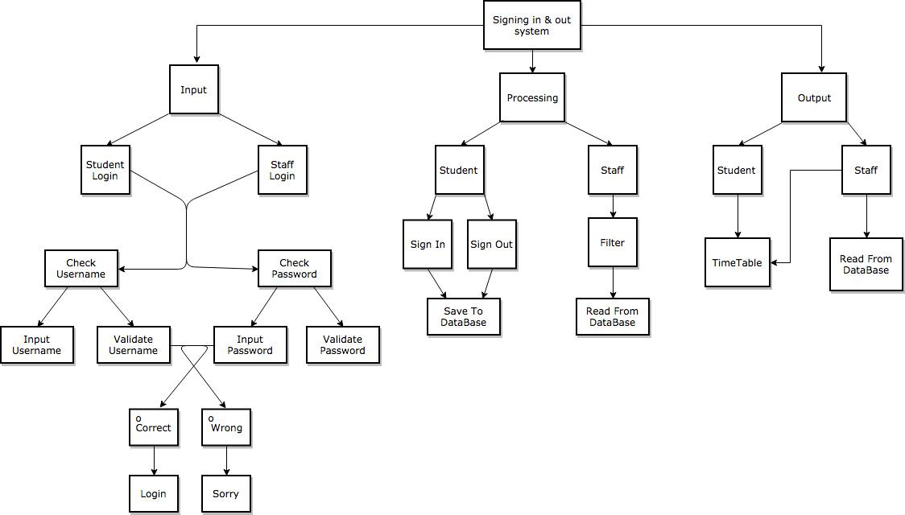
Jackson structured programming Diagram
A jackson diagram was another diagram that we created to help show the stakeholder a detailed view of our project. The jackson diagram is very similar to a flowchart but have three different branches showing the different processes and having them broken down to extremely simple boxes.

Slide 51
Project Time Scale
Requirement Analysis
Methodologies Report - Started 30th Oct - Finished 5th Mar
Stakeholder Pitch - Started 29th Jan - Finished 9th Mar
Life Cycles PowerPoint - Started 2nd Feb - Finished 5th Mar
System Requirements - Started 28th Feb - Finished 14th Mar
Evaluation Criteria - Started 28th Feb- Finished 9th Mar
Interview Information - Started 28th Feb - Finished 1st Mar
Backend Alternatives - Started 2nd Mar - Finished 9th Mar
Testing
Test Table - Started 9th Feb - Finished 24th Feb
Evaluation Criteria - Started 28th Feb - Finished 9th Mar
Design
SmartPhone Layout - Started 16th Mar - Finished 21st Mar
System Instructions - Started 15th Mar - Finished 15th Mar
DataBase Tables - Started 19th Feb - Finished 9th Mar
Evaluation Criteria - Started 28th Feb - Finished 9th Mar
Form Plans - Started 19th Feb - Finished 9th Mar
Entity Relationship Diagram - Started 19th Jan - Finished 9th Mar
Data Flow Diagram level 0 - Started 19th Jan - Finished 9th Mar
Data Flow Diagram Level 1 - Started 9th Mar - Finished 14th Mar
Information Flow Diagram - Started 15th Mar - Finished 6th Feb
Basic Use Case Diagram - Started 7th Feb - Finished 14th Mar
Class Diagram - Started 4th Mar - Finished 22nd Mar
Flowchart Diagram - Started 19th Jan - Finished 23rd March
Jackson Diagram - Started 2nd May - Finished 4th May
Implementation
System Validations - Started 28th Feb - Finished 21st Mar
The After Report - Started 1st Feb - Finished 12th Mar
Sixth Form Registration System - Started 7th Feb - 14th Mar
Issues Encountered - Started 1st Mar - Finished 23rd Mar

